Slide 1
“The Significance of Objects and their Placement”
Eleanor Yong

Slide 2
INTRODUCTION
Exploring and experimenting in my practical coursework, I started to be interested in the various perspectives artists have taken on the subject of Still Life. From doing this I have decided to concentrate on a title of “Significance of Object and their Placement”. Having started to develop my sense of understanding of artist's techniques in my coursework, in this written project I want to study the history of Still Life and its developing style through the ages by examining paintings of Still Life. I aim to analyse in depth various artists’ Still Life works from different points in their life to find similarities and differences in their own styles over time. This is to determine what their individual concerns and interests were with the “Significance of Objects and their Placement”. Looking broadly at the history of the genre of “Still Life” I would like to compare and contrast the artist’s work I have chosen and to see the development of Still Life over time.
Notes:
How presentation will benefit audience: Adult learners are more interested in a subject if they know how or why it is important to them.
Presenter’s level of expertise in the subject: Briefly state your credentials in this area, or explain why participants should listen to you.

Slide 3
TIMELINE
Juan Gris
Graham Crowley
1560
1627
1894
1913
1981
1982
1887
1927
1950
Juan Sanchez Cotan
William Scott
Ben Nicholson

Slide 4
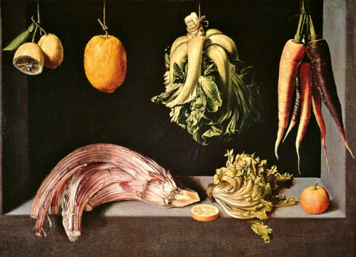
Juan Sanchez Cotan (1560-1627)
Juan Sanchez Cotan was born in Orgaz, Spain on the 25th of June 1560 and it was here that he started his artistic career. Spain was a very religious country in the Baroque era and as was the tradition, Cotan was brought up to be a catholic. Since he was heavily influenced by religion from a young age, he started off his career by painting alterspieces and religious works. He was a student of the famous still-life painter Blas del Prado whose style of realism Cotan continued to develop in his own works. As he started becoming successful, he moved to the nearby city of Toledo where, before the end of his secular life, he painted his still lifes.
The continued influence of Catholocism on Cotan prompted him to gain an interest in leading a monastic life. This is shown through the subject matter of his still life paintings as they include mostly vegetables and fruit (despite fowl and fish being in a few paintings) which was the main diet of the Carthusian monks who had a monastery in Toledo at the time.
Hanging fruit and vegetables in still life seems like a modern twist to the idea of “Suspended Animation” which is almost surreal to our 21st Century eyes. However, placing food in this way was actually a form of food preservation in the 17th century and what Cotan was painting was a simple storage space.
Still life with Fruit and Vegetables
I have chosen to study “Still Life with Fruit and Vegetables” because it has contrasting levels in the way the objects are hung compared to the majority of Cotan’s other still life works. In this painting all the elevated vegetables and fruit hang at the same height, leaving space on the surface for other objects to be placed. This gives the effect of the painting being separated into two halves horizontally. This leads the eye to follow a journey of a more horizontal form rather than diagonal one, as seen in “Quince, Cabbage, Melon and Cucumber” where the hanging food are placed in descending height order.
Notes:
Lesson descriptions should be brief.

Slide 5
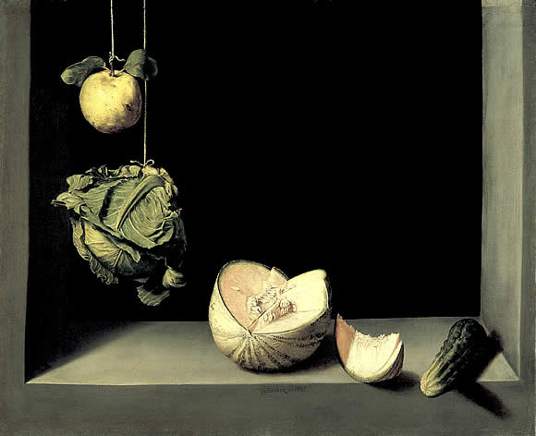
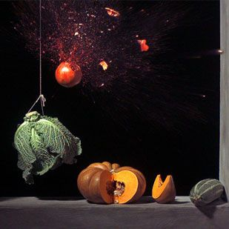
Because of the relatively small space the objects are placed in, the relationships between each curve and line seems intimate. The lack of depth and range in positioning of object also adds to the private atmosphere.
Cotan’s works involving hanging food led an artist named Ori Gersht to make a film called “Pomegranate”. Reminiscent of Cotan’s Still life works, Gersht also references 20th century scientist Harold Edgerton and his stroboscopic photography to show in slow motion a bullet cutting across the scene to obliterate a hanging pomegranate. I feel that this still from the “Pomegranate” mixes the contrasting styles of classic Baroque Still Life where the atmosphere is seen to be serene with the dynamic modern harshness of political artwork.
Quince, Cabbage, Melon and Cucumber (1602)
Since all objects are placed near the front, there isn’t much gradient between dark and light as everything is placed near a strong light source. This creates a starker contrast between the strongly illuminated foods and the darkness of the background making a strong sense of divide of line, adding weight to the objects and drama to the overall composition. This can be seen as an example of chiaroscuro, the arrangement of light and dark elements in paintings.

Slide 6
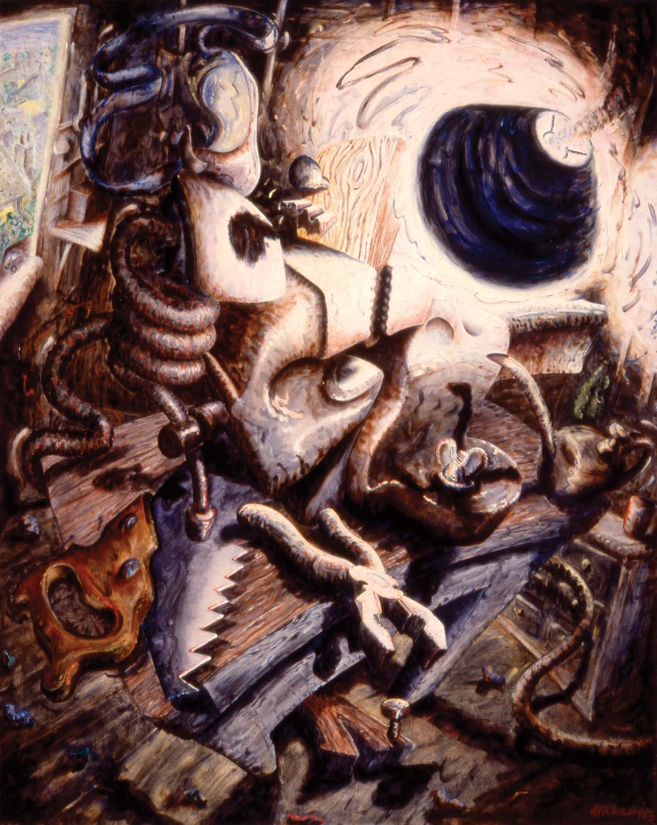
Linking back to the idea of “Significance of Objects”, I feel that Gersht continued the concept of how including objects signifying personal interests in artworks can give a more intense meaning to an overall compositon.
“A peaceful image is transformed into bloodshed,
and a dialogue is established between stillness and motion,
peace and violence”
I agree with this quote because I feel that Gersht’s film brings back a strong idea of religion and violence. Knowing that in religious artworks pomegranates were catholic representations of Jesus’ resurrection, plenitude and spiritual hopefulness, I think that the bullet represents brutality and the fact that it’s bursting through the pomegranate implies that the serenity of religion is being broken by the modern world crises and violence.
I think that whilst Cotan brought forward the idea of suspending objects in his paintings, Gersht develops the idea of hanging things to show objects mid movement and so takes this a step further to form the idea of “Suspended Animation” using film. Another artist named Graham Crowley uses the idea of “Animation” in Still Life. Like Cotan, Crowley uses everyday objects in his still lifes but instead of using film like Gersht, he uses his painting style to connote the idea of animation in still life. Crowley also uses strong light and dark tones like Cotan as they both concentrate on the placement of one strong light source in their works.
The Clampdown 1982

Slide 7
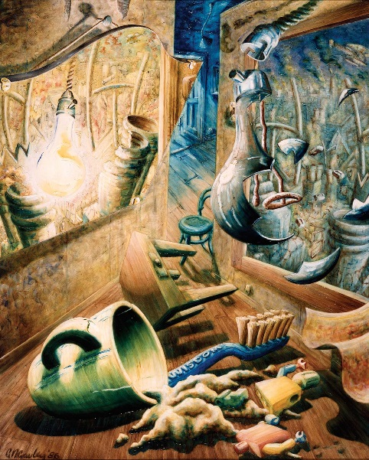
Graham Crowley (1950- )
Taking a different perspective on “Suspended Animation”, Crowley’s still life paintings contain objects that seem as though they have become animated and are coming to life. Crowley does this by exaggerating the features of each object, for example accentuating curves and line. In all his paintings Crowley concentrates on having one strong light source that illuminates the whole still life
Unlike “conventional” still life paintings, when looked at closely there are lots of scenes at play in Crowley’s paintings where one would have originally not recognised they were there at a glance. For example, in “Light Fiction” an observer would think that on each side of the walls in the painting there seems to be just an extended space. However, when studied closely there is a mirror on the left hand wall reflecting the window on the other wall. Playing with the idea of illusion and fiction, Crowley shows a shattering light bulb in the midst of falling but reflected in the mirror is a lit up light bulb. I think that this shows contrast between light and dark whilst symbolising the juxtaposition of distortion of reality that one might believe when looking into a mirror. The contrasting parallels creates an idea of broken line and completion, making the difference between light and dark greater.
“Feisty abstraction full of impossible but dynamic shapes and acute colours”
Light Fiction 1986
Like Juan Sanchez Cotan and William Scott, Crowley uses everyday objects in his still lifes. The positioning of each object gives clear contrasting angles between other objects, making the relationships between the lines more dynamic.
Graham Crowley takes sizing and proportion of his objects out of context. This makes the relationship of line and shape more intimate; showing clutter, making objects placed closer together. This for me creates a homely atmosphere alongside the warm colour palette. The warped viewpoints and perspectives gives the overall composition an uneasy and unbalanced feel which unnerves the observer. However, it also adds to the idea of motion as the painting feels restless.
Notes:
Example objectives
At the end of this lesson, you will be able to:
Save files to the team Web server.
Move files to different locations on the team Web server.
Share files on the team Web server.

Slide 8
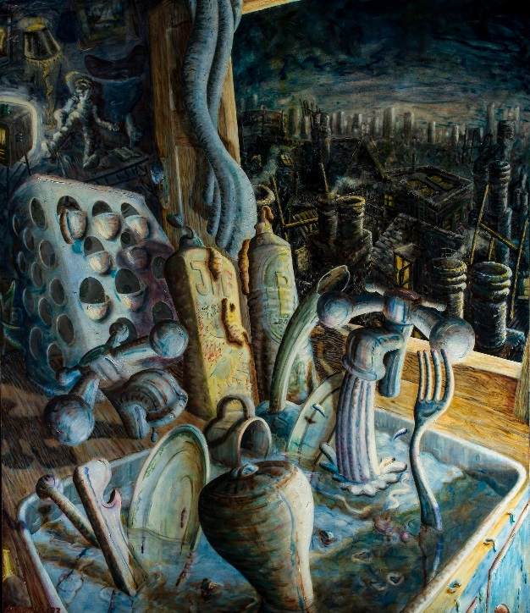
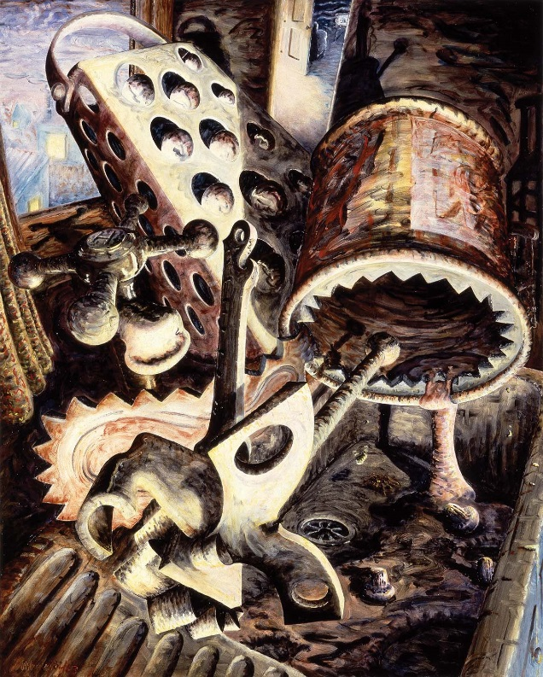
Crowley connotes movement in his paintings by making every line turn into a curve and using dramatic lighting to create shadow, not unlike chiaroscuro, along with careful placement of object. For example in “Running hot and cold” the dramatic lighting brings the piece to life as it creates the effect of mystery as the observer can only guess what goes on in the shadows. These muted tones enable Crowley to concentrate on his use of tonal gradients to imply obscurity.
Throughout these still life paintings, Crowley’s use of colour is muted. There are no sudden bright colours which stand out immensely to the observer; instead the colour palette has a unifying effect. For example, in this painting called “Spider with Mushroom Soup” the intense lighting gives the objects an almost monumental interpersonal relationship with each other. The overall environment has an excited quality to it but the muted colours add a sense of calm and mystery to the illusions.
Running hot and cold
1983
Spider with
Mushroom Soup
1982

Slide 9
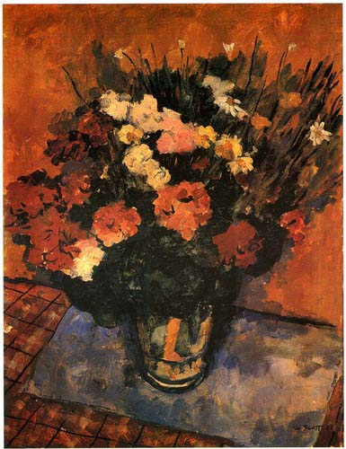
William Scott (1913-1989)
William Scott was born on February 15th, 1913 in Scotland. At the age of 11 his family moved to Northern Ireland where Scott started art classes and subsequently, his art career. He attended the Belfast School of Art and moved to London three years later to enrol at the Royal Academy of Arts. During his days at the Royal Academy, Scott’s painting style in his Still Lifes leaned towards Impressionism where the objects he uses are positioned in a careful manner.
I chose to study this painting “Flowers” because of its contrasting style to the style of painting he would later develop and be most well known for. Completed during his years at the Royal Academy, Scott uses complimentary colours and small brush strokes to concentrate on tone and contrasts of light and dark to imply shadow. This can be seen from the contrasting white flowers and the thick black spaces within the bunch of flowers representing shade. Scott also uses line to imply ideas within this painting, leaving detail to be imagined by the observer. For example, the types of flowers aren’t recognisable as Scott positions blocks of colour with subtle differing tones in them to give the overall impression of what they are.
The surface of the table in “Flowers” shows a tilted plane since there is a lack of depth and there is almost no difference between the table and wall apart from a line differentiating the two. Compositionally in this painting it is clear from what angle Scott was observing the still life but as the lines of the tablecloth don’t stay consistent, this gives me the impression that it was at around this time that Scott was starting to develop a sense of changing perspective.
Flowers, 1938
I feel that the opposing angle of the small brush marks gives the painting a sense of dynamic movement and excitement despite the likelihood that there was no motion involved with the still life. I find this misleading.

Slide 10
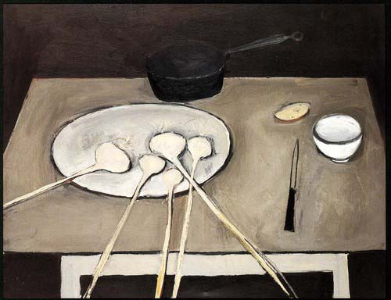
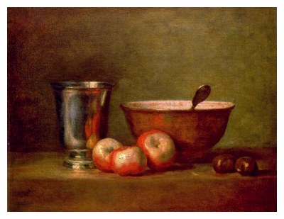
Unlike in his Academy days where he tended to use more classical objects in his still lifes like flowers, Scott started concentrating on using common-place items, much like Cotan and Crowley do in their works to make their pieces seem less decorative and more about domestic life. Scott used items such as eggs, bottles, pots and frying pans as subjects of his still lifes. In using these items and placing them on plain surfaces such as a kitchen table, I think that this adds contrast between the line of each individual item. Scott stated that another reason why he used and placed these objects on plain surfaces was because he wanted …
“Objects without glamour,
I wanted my pictures to have a painting,
not literary success”.
Still Life with Garlic, 1947
After Scott graduated from the Royal Academy he stated that he wanted to look “Through the eyes of Chardin”, implying that he was aiming to continue his works based on still life just like the great 18th century painter. Chardin is considered to be a master of still life and is known to have very balanced composition within his paintings. Since Chardin is also noted for his use of every day domestic activities in his paintings, I feel that this influenced Scott in his choice of every day kitchen utensils in his still lifes.
Alongside Scott’s changing choice of still life objects, his perspectives within the still life also started to shift. For example in “Still Life with Garlic” the table on which the objects are positioned is tilted away from the observer and the plane of the whole still life is placed as the observer would see a table from a standing height looking down. The objects in “Still Life with Garlic” are relatively spaced out, giving a sense of a balanced composition within boundaries of the table.
Still Life with Silver Cup 1769- Chardin

Slide 11
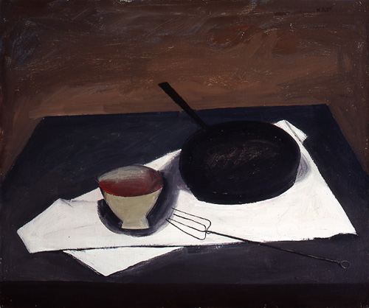
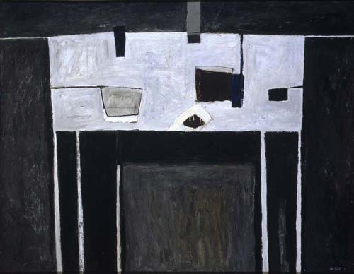
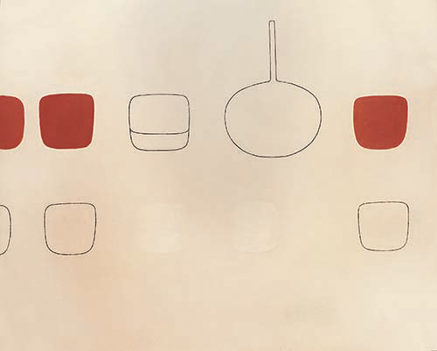
The Frying Pan 1946
Table Still Life, 1951
Egypt Series No. 2 1972
By the 1950’s Scott’s perspective on still life shifted again as the plane of the table has become completely flat. The table legs in “Table Still Life” don’t fit in conjunction with the perspective one would have in real life looking down at a table. Studying this painting it is as if Scott joined different viewpoints of each object and joined them into one painting to create an abstract form which has no one true perspective. The table is on a completely flat plane, with a viewpoint like a bird’s eye view on the table and the table legs and saucepans are painted as if one saw them looking at them from the side. This reminds me of Cubism and the works of Juan Gris where all aspects of an object are shown at once to the observer using geometric shape. When before there was an evident sense of depth, by the 1950’s this had gone from his paintings. Scott continued to develop his idea of placement of object and his surface plane also continued to flatten whilst balancing shape and colour. In the 1970’s he was using even less blocks of individual colour and he had stripped every object of detail to get only very basic line and shape.
In “Egypt Series No. 2” most objects are unrecognisable as the observer is only given basic shapes to interpret and the spacing between each object shows patterns of being placed in lines and in specific orders. Like Ben Nicholson, Scott has stripped away everything that defines an object apart from its outlined shape and moves towards abstraction.

Slide 12
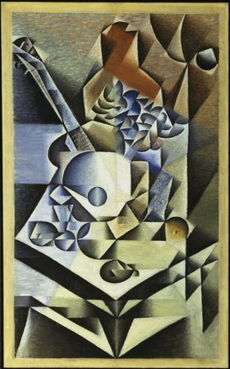
Juan Gris (1887-1927)
Juan Gris was born in Madrid to an artistic family and as his father was a painter and sculptor, his first Still Life works were influenced by the style of his father. After moving to Paris in 1906, Gris befriended Pablo Picasso and Georges Braque, who influenced him at the start of his artistic career and with whom he would later be identified with as the leaders of Cubism. Inspired by their artistic styles, Gris also started painting in a cubist manner. However, it was only in 1911 that Gris started painting seriously, 5 years after Picasso and Braque developed Analytical Cubism. In “A Life of Picasso” by John Richardson, he writes that Jean Metzinger’s 1911 work, Le goûter (Tea Time), persuaded Gris of the importance of mathematics and numbers in painting.
Gris joined the Cubist movement during the period of Analytical Cubism (1907-12), where the colour palette was very much limited to more tonal colours of blacks, browns, greys and off-whites. As shown in this painting “Still Life with Flowers” which he painted in 1912, the form of each shape has a rigid geometric quality to it, as was typical.
Despite all the differing directions of depth and small geometric sections in “Still Life with Flowers” there is still an illusion of solid form. The objects in this still life are broken up but the interplay of line makes the shapes balance out to form a coherent dialogue so that they work together to create a comprehensible piece. Because of this the perspective is clear and an image of a table, guitar and some flowers placed on top of it are visible.
There is no overall clear depth shown like in the still life images Cotan creates, however, the subtle tonal differences within the fragments adds a shallow sense of depth in different directions.
Still life with Flowers 1912

Slide 13
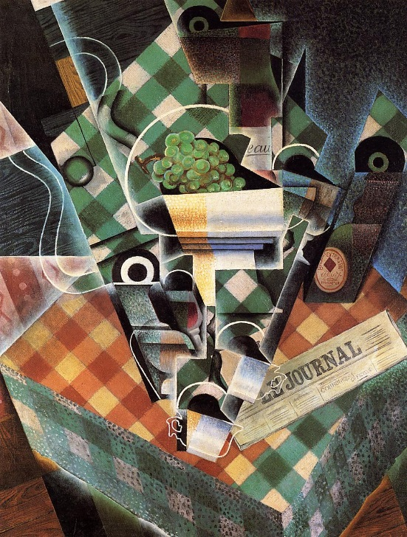
Following the Analytical Cubism movement (1908-1912) was the Synthetic Cubism movement (1913-20’s) and it was in this time that Gris painted “Still life with chequered table cloth” 1915. The work in Synthetic Cubism contains fewer and more simpler forms than Analytical Cubism. The use of more variations of colour was introduced and cubist pieces started to become a bit more decorative whilst many artists used collage in their compositions.
“The cubists sought to show everyday objects as the mind,
not the eye, perceiving them-from all sides at once” ^{[1]}
Here in “Still life with chequered table cloth” the planes of the table and the objects on it are different, showing contrasting perspectives much like William Scott. There is still a sense of division of line but much less so compared to “Still Life with Flowers”. Interconnecting line and the placement of object in this pieces makes the image have an intimate feel to it and an almost monumental one as all the objects seem to be placed in the centre of the table.
Each dividing line has a clean cut sharp edge to it and the tone in each sectional shape is subtle and intricate. Gris uses shapes and line to divide the canvas into defined crystalline sections. This geometric form of fragmentation juxtaposes the lighter and darker sections of this piece and the subtle graduation of tone forges a spatial relationship between each fragment to create vague shapes when looked at from a distance.
Still life with chequered table cloth.
1915
The vibrant colours that Gris uses in his works at this period in time contrasts to that of Picasso and Braque as they still used a similar colour palette to that which they used during the period of Analytical Cubism.
^{[1]} http://www.infoplease.com/encyclopedia/entertainment/cubism-analytic-synthetic-cubism.html

Slide 14
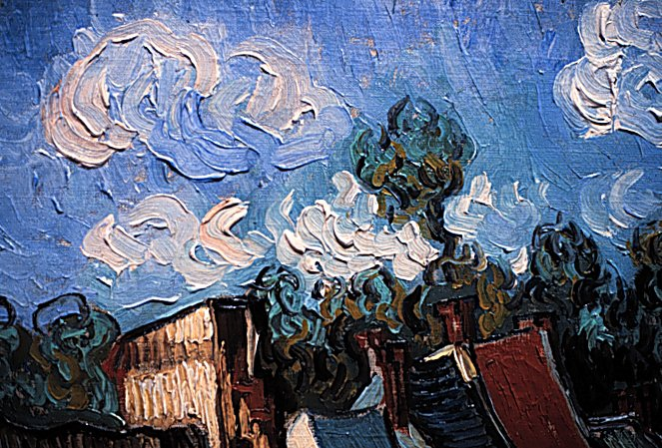
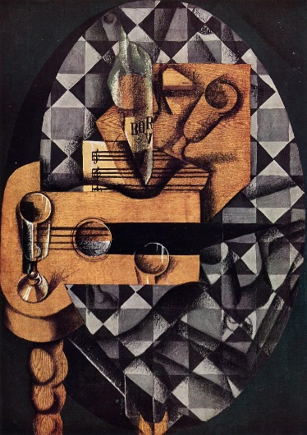
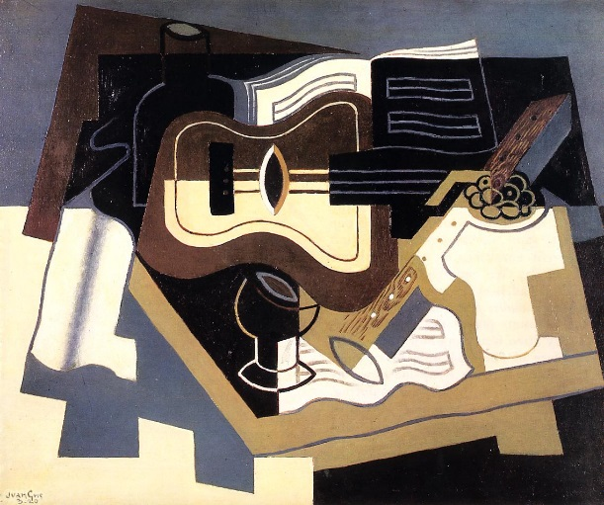
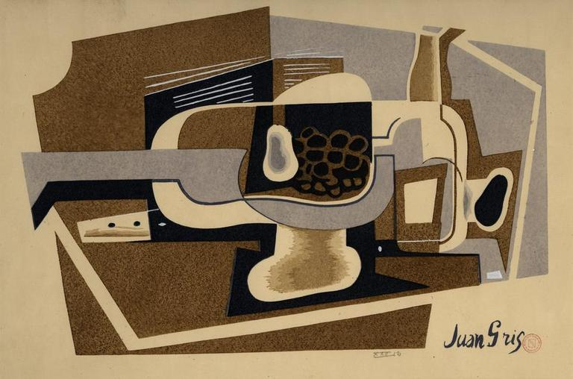
Instead of the placement of object, the placement of sections in Gris’ paintings are significant because of the way it is arranged to create an understandable image. Like Van Gogh places his brushmarks carefully in his piece “Houses in Auvers” using an impasto technique to create shape, Gris uses small well defined fragments instead to do this.
An effect I noticed whilst studying Gris’ works is that, just like William Scott, as time progressed the planes that Gris works with, such as the tables and surfaces, become a lot flatter. Just like Scott, perspectives start to range as surfaces tilt back whilst objects placed on it are painted from different angles. The sense of line and shapes of object start to become a lot simpler as time goes on and small complex fragments are replaced with larger more basic components to create overall shapes.
Houses at Auvers 1890
Guitar, Bottles and Glass 1914
Guitar and Clarinet, 1920
Still Life 1922

Slide 15
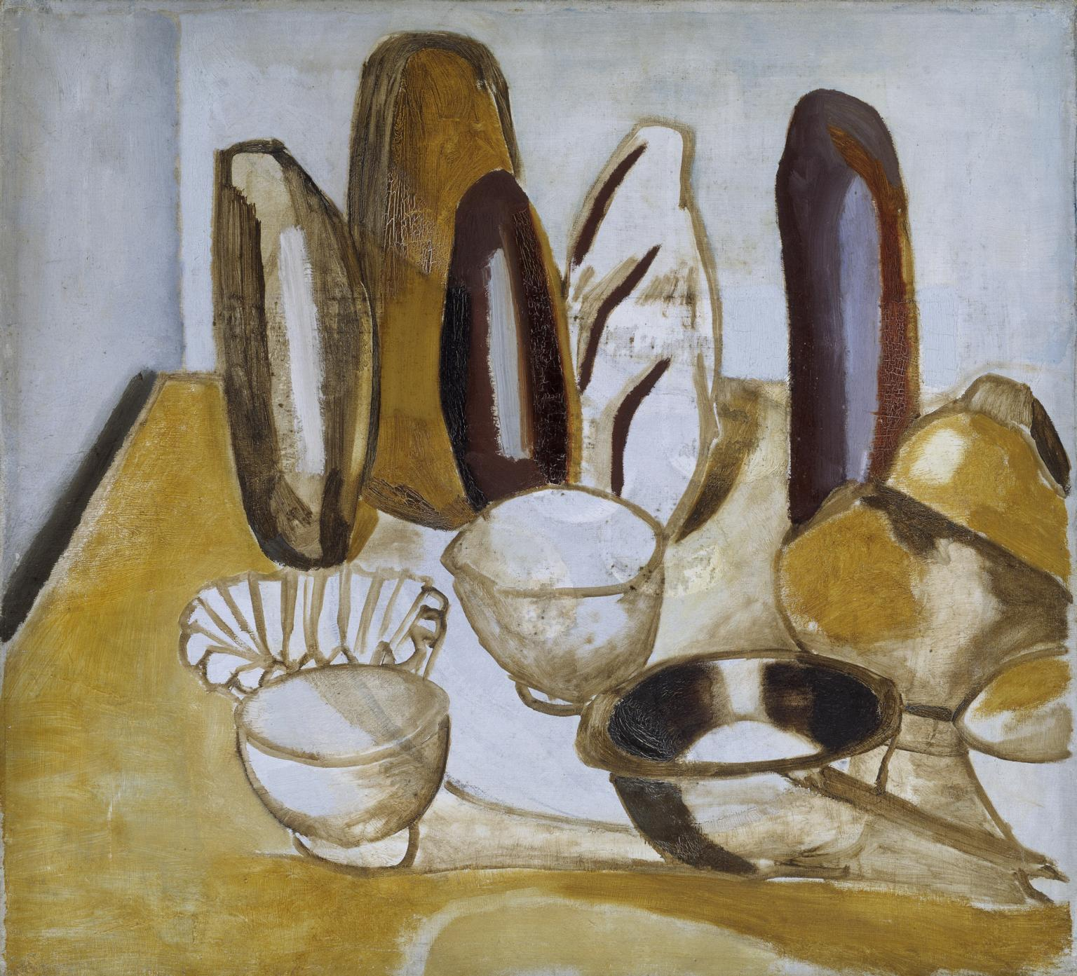
Ben Nicholson (1894-1982)
Coming from a very artistic family with both parents and uncle being artists, Nicholson had very little formal artistic training. However, from his one term at Slade School of Fine Art in 1911 Nicholson was introduced to working with every day objects such as jugs, cups, mugs and bottles; objects which in his later life would be frequent subjects of his still life works.
One of the earlier works in Nicholson’s career, “Bread” was painted as an experimental approach to Still Life. At this period in time Nicholson was concentrating on landscapes and this painting was an aim to move away from the sophisticated style of painting he developed earlier and from the typical style of painting his father used.
I chose this painting to study first because I feel that even in his early works Nicholson shows a definite sense of line to dominate shape rather than using tone, a style he would develop as he went on in his career.
In the late 1920’s, Nicholson’s style of still life started to show more rigid structure and sense of line as he was influenced by Cubism in its last years. Due to his second marriage to Barbara Hepworth (a sculptor) in 1931, Nicholson started making frequent trips to Paris to visit the studios of Piet Mondrian, Georges Braque, Juan Gris, Picasso and other leading artists. It was under these artists influence that Nicholson was prompted in 1933 to convert to abstract art.
Bread 1922
The objects in the painting are placed almost on top of each other in the corner, giving the painting an intimate and private feel in such a small space. The fact that the loaves of bread are standing on their ends results in very strong vertical forms dominating this image with their heavy sense of line which also gives the painting a monumental atmosphere. This acts as a contrast with the almost transparent bowls where any form or line behind the object might show through.

Slide 16
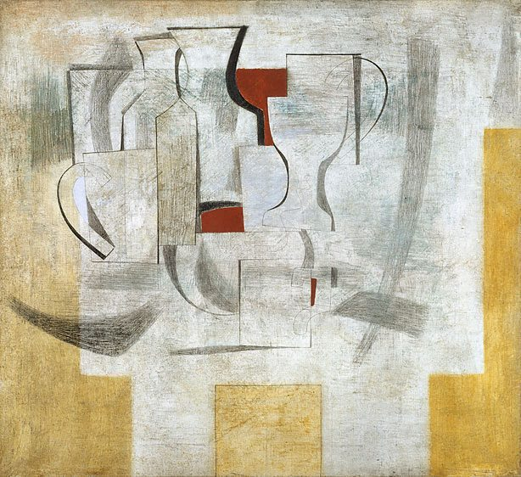
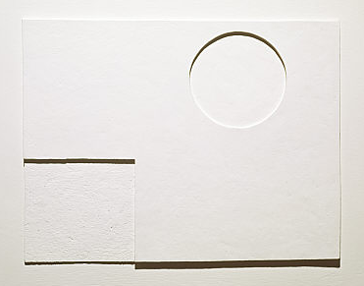
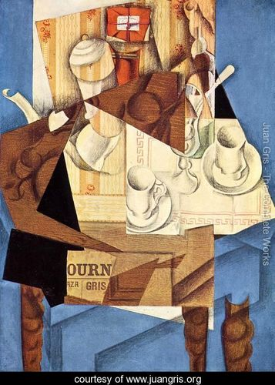
Works produced at this time, for example “White Relief” in 1935, shows clear geometric line using circles and rectangles with uniform colours. Vastly different to his earlier works, Nicholson starts to concentrate on the importance of line to connote shape and structure. The contrasting shapes of circles against rectangles, curves against straight lines, gives the image a dynamic atmosphere but the pure white tone adds an aspect of severity to the composition.
After his relief artworks, in 1945 Nicholson reverted back to working with his style of abstraction where he keeps elements of reality present. I think that the influence that Cubism had on the artist is evident from this artwork called “Alice through the looking glass”.
Whilst “White Relief” is not known as a still life piece but as a form of non-objective art, it is clear that Nicholson is only interested in very basic shape and clean line, simplifying all aspects of imagery to elemental features creating minimalism.
Alice through the looking
glass still life 1945
Like the cubists and Juan Gris, he relies on interpersonal line to join separate shapes together to create form. Various bold outlines of shape and minimal use of colour creates interest and drama in the composition, adding contrast to the otherwise very plain and simple format.
White Relief 1935
Breakfast 1914- Juan Gris

Slide 17
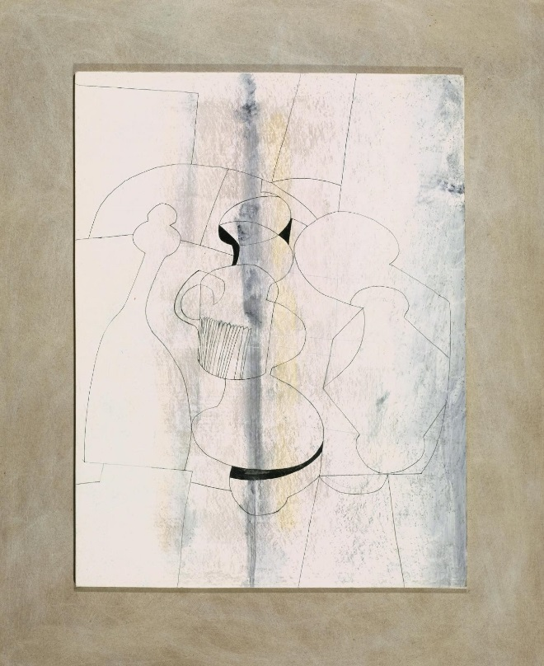
Compared to “Bread” which was done 1922 this painting done in 1945 has a flattened table plane as opposed to one with a strong sense of angular perspective. Like Scott, Nicholson’s plane for the still life has tilted back and his still life objects are drawn on as if viewed sideways on a table.
In 1941, Nicholson wrote that looking at abstract paintings should be easy:
“There is no need to concentrate;
it becomes a part of living.
I think that so far from being a limited
expression, understood by a few,
abstract art is a powerful, unlimited
and universal language.”
Alice through the looking glass still life
1945
Vertical Stripe 1972
Studying his drawings later on in his career, it is noticeable that he strips away some basic elemental aspects of art including colour and depth to leave line, very simple form and space, for example, in “Vertical Stripe”. A few shapes are still recognisable for example there is an outline of a cup or mug and something that looks like a pepper grinder but there is no indication as to whether they or the environment were particularly significant to Nicholson or not.
Table Still Life, 1951- Scott

Slide 18
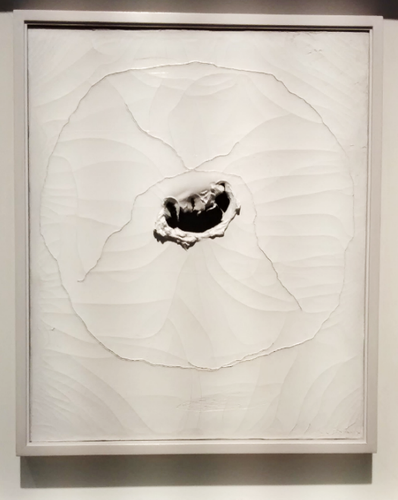
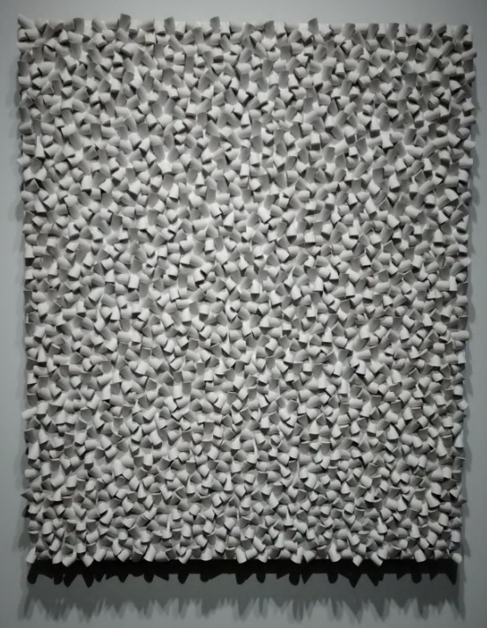
Sotto Voce- Dominique Lévy Gallery
Exploring the idea of line and space in the Still Life works of the artists that I have chosen, I visited a gallery in London called Sotto Voce, an exhibition uniting artists working with abstract white reliefs. Concentrating on the progression of abstract white reliefs geographically and through time, this exhibition was focused on the time period between the 1930’s and 1970’s. Whilst all artworks were “White Reliefs” the exhibited artists ranged from a variety of movements such as Surrealism, the Zero Group, Spatialism, Minimalism, Conceptual Art and Constructivism and they were at the forefront of their respective movements.
“While the white palette may give the works a soft voice, their messages are loud and clear,
whether they are cries of hope,
an attempt at nothingness,
an expression of aesthetic idealism,
or a surge towards transcendence.”
Linking back to the main title of “Significance of Objects and their Placement”, while this exhibition doesn’t address the title directly, I have found that throughout all the artworks I have analysed line and spacing was a key factor to the structure of an overall composition. Once you have stripped the artwork of all basic artistic principles like colour, tone and depth, I have found that the placement of line is just as important as the placement of the object it is defining. White Reliefs show only the elemental and basic aspects of art and the contrasts between the differing styles of rhythm for example between Sergio Camargo and Lolo Soldevilla shows that the idea of division of line and structure varies between artist to artist.
Lucio Fontana- Concetto spaziale 1964
Sergio Camargo studied under Lucio Fontana, however, I think that their styles are drastically different. Camargo’s experimentations with abstraction led to the creation of his archetypal white reliefs which compromised of painted wooden cylindrical elements where the spirals fill up the frame, evoking a movement from the individual part to the multiple whole, floating in a dimension between painting and sculpture.
Sergio Camargo- Untitled (288) 1970
Lolo Soldevilla- Composicio Concreta-1955

Slide 19
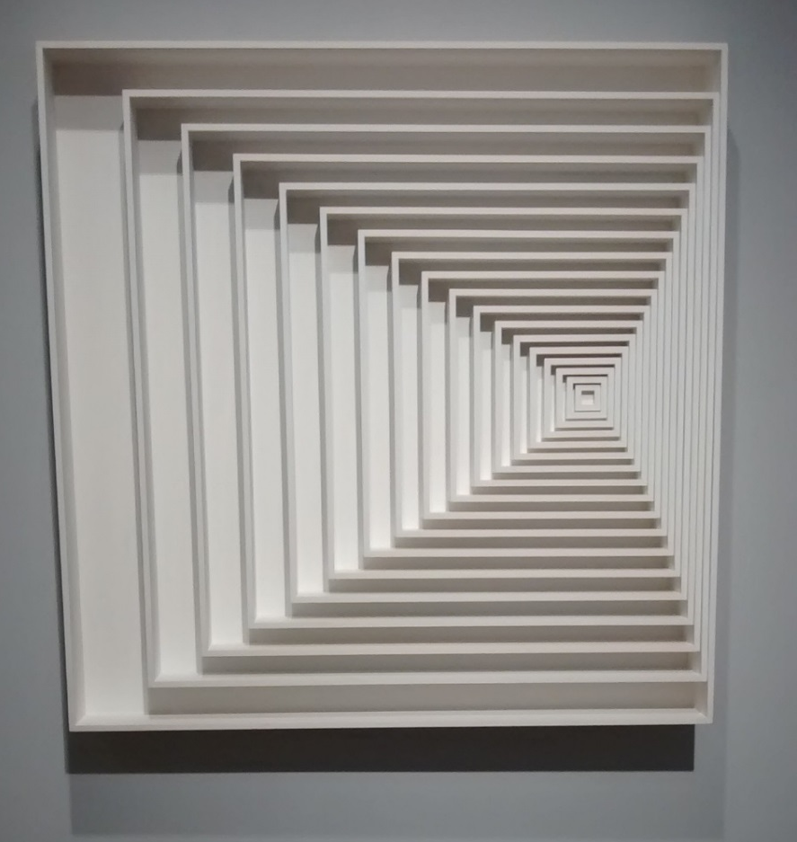
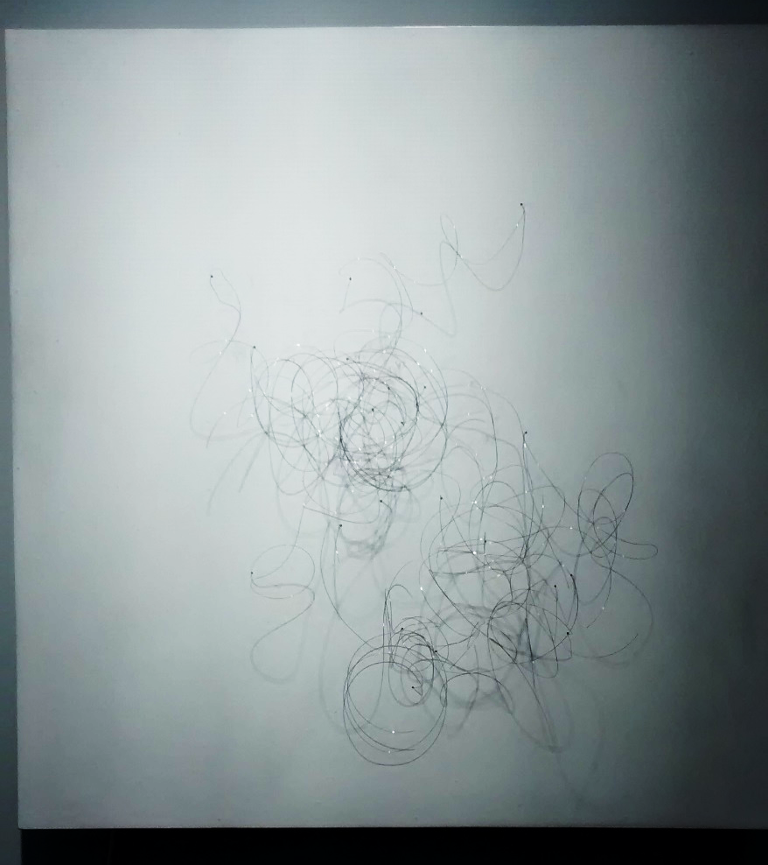
Ascanio Mmm- Relevo Quadrados 23 1968-2006
Gunther Uecker- Wind 2009
Pol Bury- Erectile 1959
Observing the exhibition and the various interpretations of use of line from each artist, I was intrigued see how each artist perceives
the balance of line. For example Gunther Uecker’s “Wind” was an ever-changing spectacle, leaving the observer transfixed and entranced
by the simple placement of nails on a wooden board to envision energetic wind currents. Compared to Pol Bury’s “Erectile” which was formed
of only wire on white board I thought that “Wind” was a lot busier and created a 3D effect where as the thin wire used by Pol Bury
added a heightened sense of delicacy where the light cast shadow on it causing double thin dark lines to appear on the white board,
giving another sense of illusion. In all of these artworks I found that the placement of light was crucial to the emotion evoked by the piece.
Though simple in colour I found that a lot of emotion was conveyed through placement of line.

Slide 20
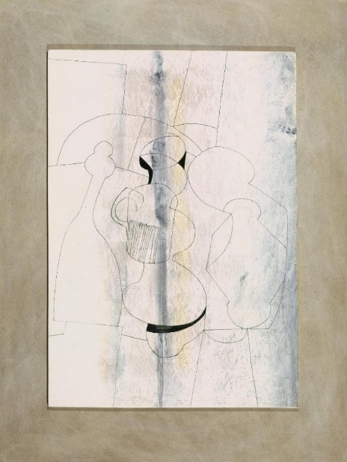
History of Still Life Timeline
Still life with chequered table cloth
- Juan Gris
Alice through the looking glass still life
- Ben Nicholson
Table Still Life- William Scott
Egypt Series No. 2 – William Scott
1951
1972
1915
1945
Quince, Cabbage, Melon and Cucumber - Juan Sanchez Cotan
Guitar and Clarinet – Juan Gris
Still Life with Garlic-William Scott
Vertical Stripe-Ben Nicholson
Light Fiction – Graham Crowley 1986
1602
1920
1947
1972

Slide 21
Conclusion
Having explored the development of “Still Life” through history and “Significance of Objects and their Placement” from Juan
Sanchez Cotan’s hyper realistic paintings to Ben Nicholson’s basic line and from Graham Crowley’s “animated” scenery to Gris’ Cubist works, I feel that I have a greater understanding of the importance and Significance of Objects and their Placement. Comparing and cross referencing artists I have realised that whilst all interpretations of Still Life would be different for every artist, there would still be certain attitudes that have stayed consistent during time. I have found that the take on “Still Life” has metamorphosed over time and analysing their individual journeys and concerns with styles through the ages I think that whilst object in still life would always be of personal importance to the artist, the placement of line itself was the most important and underlying fundamental thought to the structure of a composition, something I thought I would not discover in this project. In this project I also learned of the importance of contrasts between light and dark for the meaning of the painting to be recognised. To conclude, I would say that with Still Life and “Significance of Objects and their Placement” there was a growth in creativity in the 20th century in this field as there are now more materials to express this such as the video work of Ori Gersht, new approaches to painting and intermedia displays. I think that the Cubist movement was a catalyst in this process because of its emphasis on line and fragmented shape to convey scenes and these ideas are still being explored by artists today.

Slide 22
Bibliography

